Slide 1
Go Language
Sally Tong
2018-03

Slide 2
Agenda
Why Go
Install
Hello world
Function/Method
Struct
Interface
Goroutine
Channel

Slide 3
Why Go?
Simple
- relatively simply language
- concurrent-friendly language: goroutines and channels
- simple standard library
- has Garbage collection, user don’t need manage memory
Quick
- very few time to compile
- run fast, performance as C/C++

Slide 4
Install in Linux
download tar.gz. For example:go1.10.linux-amd64.tar.gz from https://golang.org/doc/install
Extract the file to /usr/local
#tar -C /usr/local -xzf go1.10.linux-amd64.tar.gz
Setup two environment variables:
# echo 'export GOPATH=$HOME/go' >> $HOME/.profile
# echo 'export PATH=$PATH:/usr/local/go/bin' >> $HOME/.profile
Active the two variables
# source $HOME/.profile

Slide 5
HelloWorld
Code example:
Run:
- option1: - option2:
go fmt
$go fmt helloWorld.go
package main
import "fmt"
func main() {
fmt.Println("hello world")
}
$ go build helloWorld.go
$ ls
helloWorld helloWorld.go
$ ./ helloWorld
Hello,world
$ go run helloWorld.go
hello,world

Slide 6
Functions/Method
Functions in Go can take zero or more arguments, and they can return zero or more values. There are no classes in Go, just functions
Method
one kind of Function, along with a Data Type
func log(message string) {
}
func add(a int, b int) int {
}
func power(name string) (int, bool) {
}
type myInt int
Func (i myInt) add(another int) myInt{
i = i + myInt(another)
return i
}
i1 := myInt(1)
i2 := i1.add(2)
fmt.Println(i1,i2)

Slide 7
Structs
Structs in Go are just typed collections of fields.
Declarations and Initializations
type Student struct {
Name string
Score int
}
Lucy := Student{
Name: “Lucy",
Score : 80,
}
Lucy := Student{}
Lucy := Student{Name:”Lucy”}
Lucy. Score = 80
Lucy := Student{“Lucy”, 80}

Slide 8
Structs
Functions on Struct
Fields of Struct
type Student struct {
Name string
Score int
}
func (s Student) Introduce() {
fmt.Printf("Hi, I'm %s.\n", s.Name)
}
func (s * Student) WorkHard() {
s. Score += 20
}
type Student struct {
Name string
Score int
Classmate *Student
}

Slide 9
Structs
Composition
Overloading
type Person struct {
Name string
}
func (p *Person) Introduce() {
fmt.Printf("Hi, I'm %s\n", p.Name)
}
type Student struct {
*Person
Score int
}
// and to use it:
Lucy := & Student{
Person: &Person{“Lucy"},
Score : 80,
}
Lucy.Introduce()
func (s *Student) Introduce() {
fmt.Printf("Hi, I'm %s, a student", s.Name)
}

Slide 10
Interfaces
It is automatically known to be interface simply by virtue of whether or not Go can find methods of the indicated signature in scope
type Apple struct {
JuicePecent int
}
type Orange struct {
JuicePecent int
}
func (a Apple) Juicing() {
fmt.Printf("Juicing an Apple! Got %d juice\n", a.JuicePecent)
}
func (o Orange) Juicing() {
fmt.Printf("Juicing an Orange! Got %d juice\n", o.JuicePecent)
}
type Fruit interface {
Juicing()
}
func JuicingFriuit(f Fruit) {
fmt.Println(“Juicing Fruit...")
f. Juicing()
}
func main() {
apple := Apple{80}
orange := Orange{90}
JuicingFriuit(apple)
JuicingFriuit(orange)
}

Slide 11
GoRountine
A goroutine is similar to a thread, but take memory less than thread
it is scheduled by Go, not the OS
package main
import (
"fmt"
"time"
)
func main() {
fmt.Println("start")
go process()
time.Sleep(time.Millisecond * 10)
fmt.Println("done")
}
func process() {
fmt.Println("processing")
}
Use go keyword to start a goroutine
go routine run with main thread at same time

Slide 12
GoRountine
package main
import (
"fmt"
"time"
"sync"
)
var (
counter = 0
lock sync.Mutex
)
func main() {
for i := 0; i < 20; i++ {
go incr()
}
time.Sleep(time.Millisecond * 10)
}
func incr() {
lock.Lock()
counter++
fmt.Println(counter)
lock.Unlock()
}
package main
import (
"fmt"
"time"
)
var counter = 0
func main() {
for i := 0; i < 20; i++ {
go incr()
}
time.Sleep(time.Millisecond * 10)
}
func incr() {
counter++
fmt.Println(counter)
}
At one time, Just one goroutine can go to Critical area
In a processer, if one goroutine take long time, it may stop by Go scheduler and let other goroutine run

Slide 13
Channel
Aim: sharing data, like a first-in-first-out queue
Define a channel
c := make(chan int) //unbuffered Channel
c := make(chan int, 100) // Buffered Channel
Receiveing data
c <- DATA
Sending data
VAR := <-c, VAR, ok := <-c
Operation
At one time, just one goroutine can send data to a channel, and just on goroutine can receive data from a channel

Slide 14
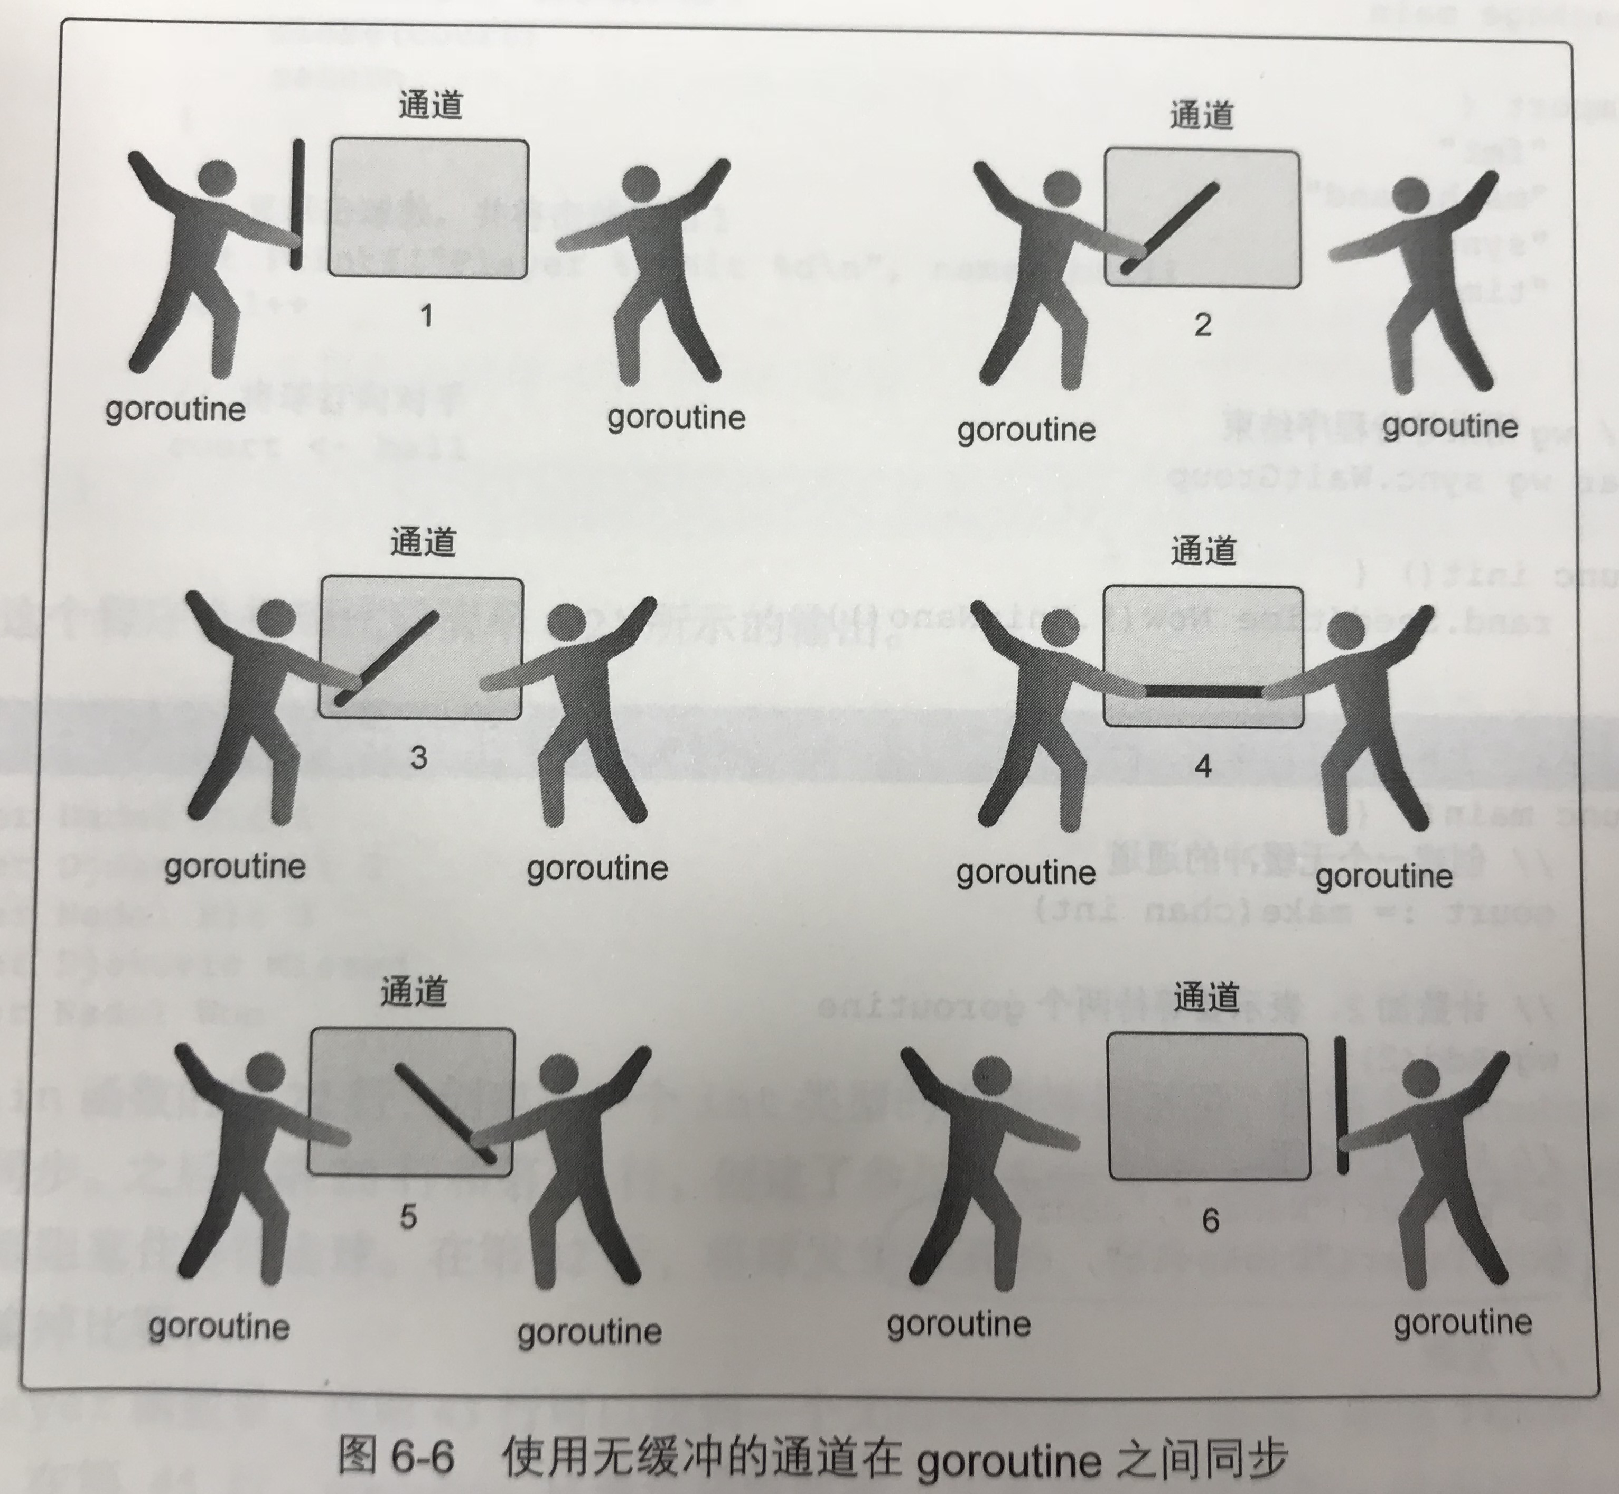
Unbuffered Channel
Bothe Send goroutine and receive goroutine ready at same time
Who act first who block first

Slide 15
Unbuffered Channel
M
1
2
3
4
1
2
3
4
func Runner(baton chan int) {
var newRunner int
runner := <-baton
fmt.Printf("Runner %d Running with baton \n", runner)
if runner != 4 {
newRunner = runner + 1
fmt.Printf("Runner %d To the Line\n", newRunner)
go Runner(baton)
}
time.Sleep(100 * time.Millisecond)
if runner == 4 {
fmt.Printf("Runner %d Finished, Race Over\n", runner)
wg.Done()
return
}
fmt.Printf("Runner %d Exchange with Runner %d\n", runner, newRunner)
baton <- newRunner
}
package main
import (
"fmt"
"sync"
"time"
)
var wg sync.WaitGroup
func main() {
baton := make(chan int)
wg.Add(1)
go Runner(baton)
baton <- 1
wg.Wait()
}

Slide 16
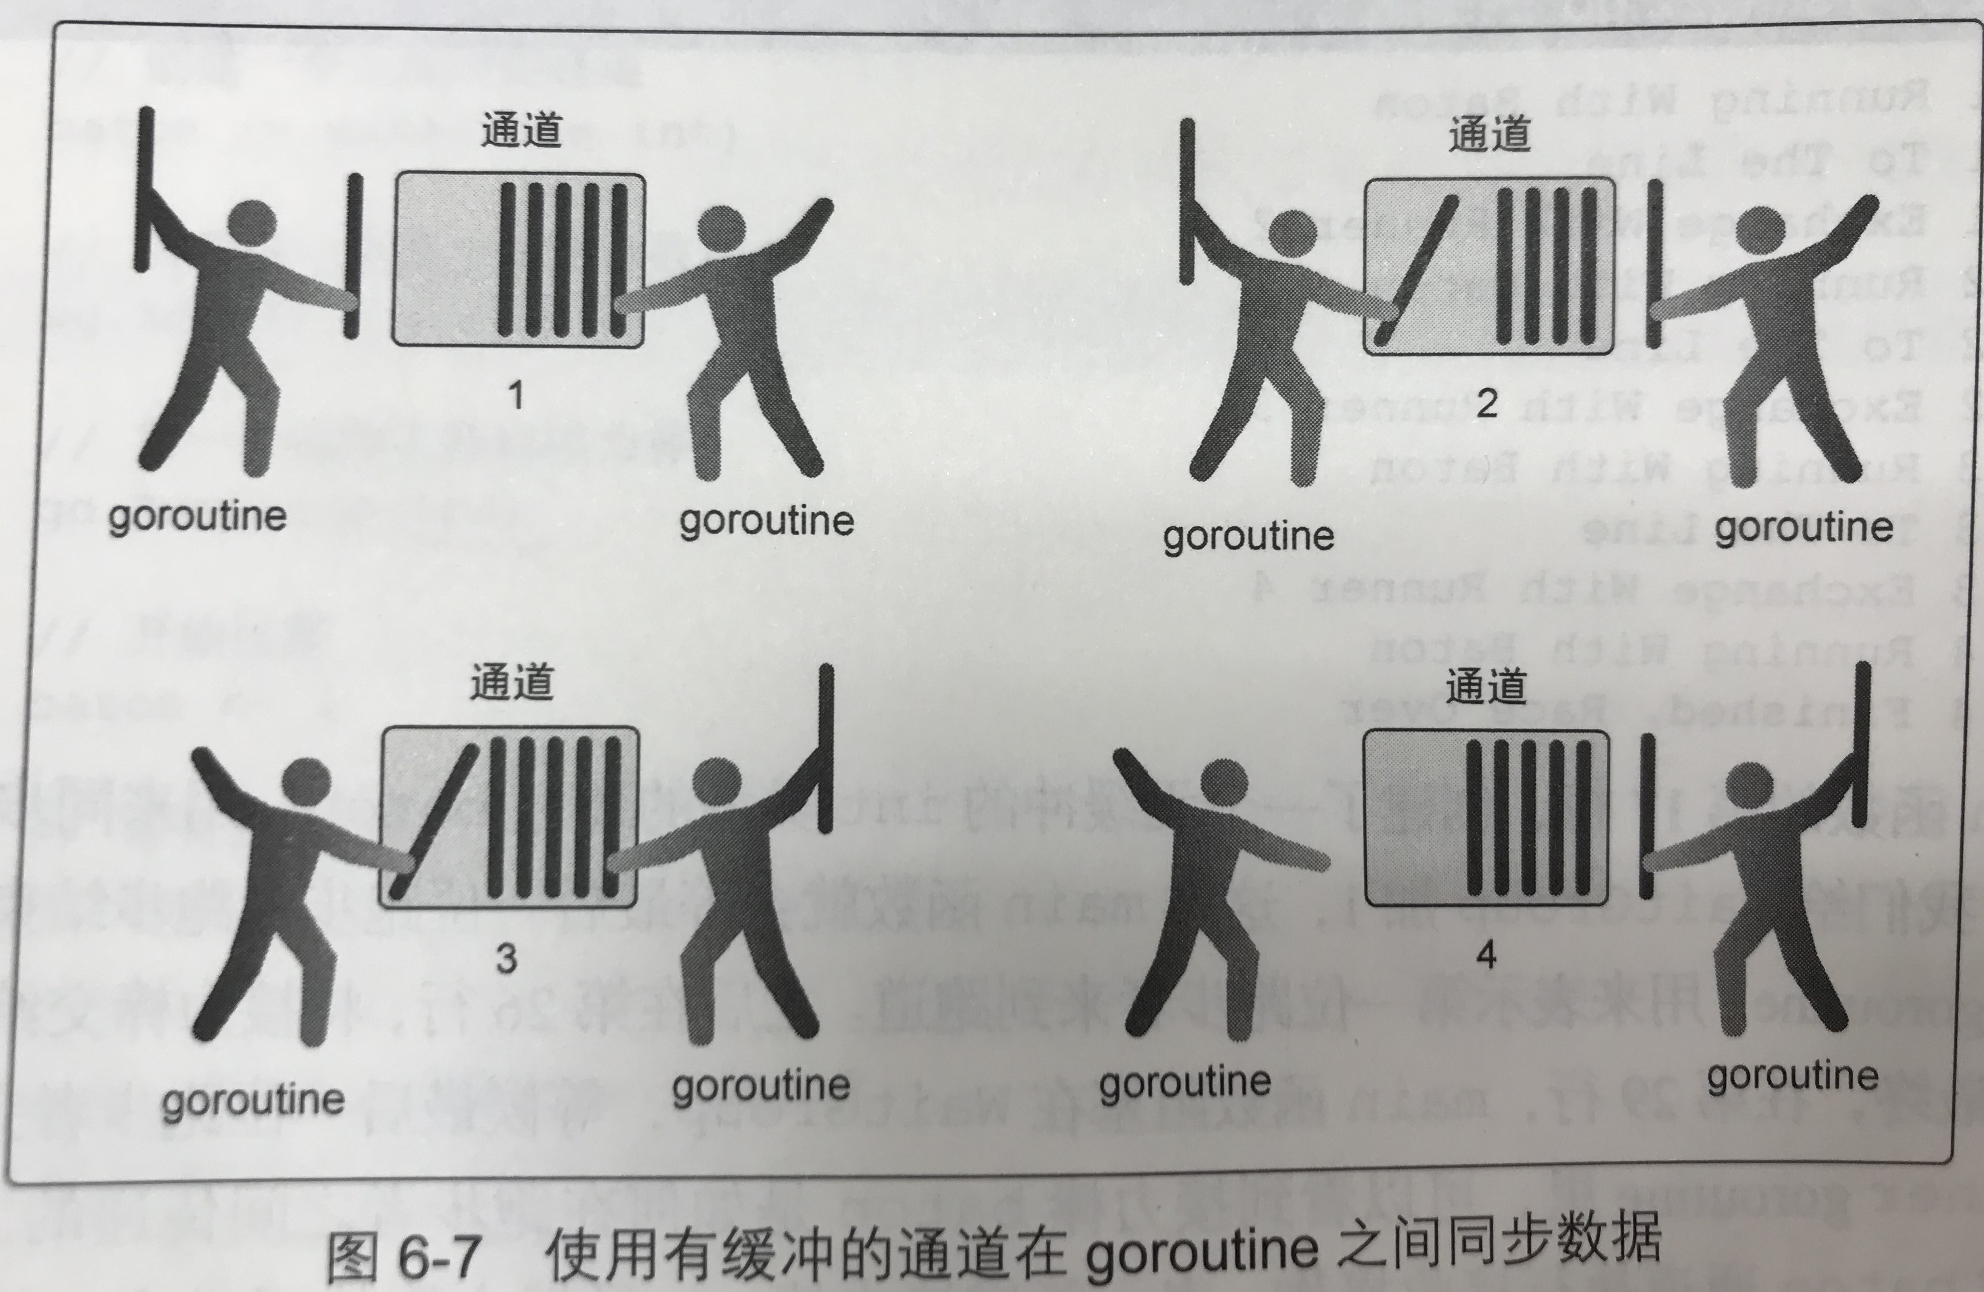
Buffered Channel
If the buffer is empty, the receive routine block
Once the buffer has data, the receive routine active
If the buffer is full, the send routine block
If the channel is closed, the receive routine can receive data until all data received

Slide 17
Buffered Channel
go func() {
for _, elem := range []string{"a", "b", "c", "d"} {
strChan <- elem
fmt.Println("Sent:", elem, "[Sender]")
if elem == "c" {
syncChan1 <- struct{}{}
fmt.Println("Sent a sync signal. [Sender]")
}
}
fmt.Println("Wait 2 seconds ... [sender]")
time.Sleep(time.Second * 2)
close(strChan)
syncChan2 <- struct{}{}
}()
<-syncChan2
<-syncChan2
}
var strChan = make(chan string, 3)
func main() {
syncChan1 := make(chan struct{}, 1)
syncChan2 := make(chan struct{}, 2)
go func() {
<-syncChan1
fmt.Println("Received a sync signal and wait... [receiver]")
time.Sleep(time.Second)
for {
if elem, ok := <-strChan; ok {
fmt.Println("Received:", elem, "[receiver]")
} else {
break
}
}
fmt.Println("Stopped.[receiver]")
syncChan2 <- struct{}{}
}()

Slide 18
Reference
Go Website https://golang.org
Go example https://gobyexample.com
Test your code online: https://play.golang.org
Go materials: https://github.com/wonderfo/wonderfogo/wiki
《Go并发编程实战（第2版）》
《Cloud Native Go》如何构建基于Go和ReactJS技术的基于云平台的微服务架构应用。

Slide 19
Thank you

